Slide 1
Technical Quiz
Saivivek Therala, Thirupathi Gandla

Slide 2
Key Features
Multiple Choice questions
Validating the answers and scoring
Navigation bar
Demo run of the application

Slide 3

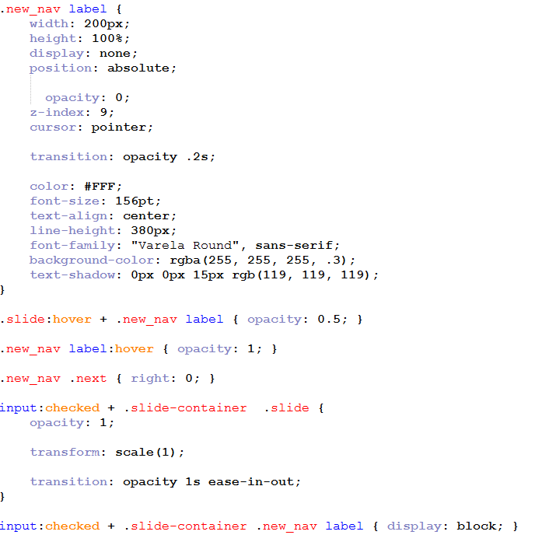
Image Animation

Slide 4
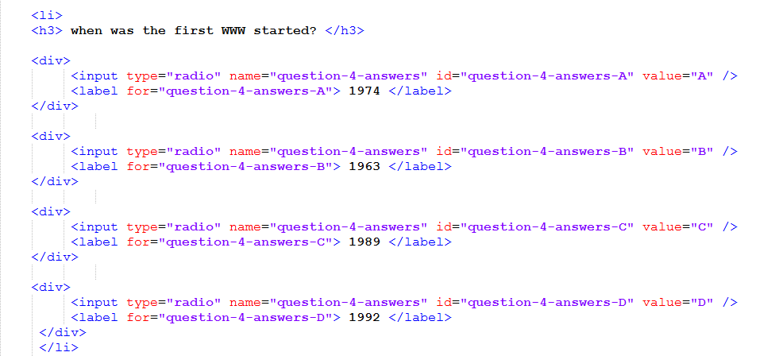
Multiple Choice Question

Slide 5
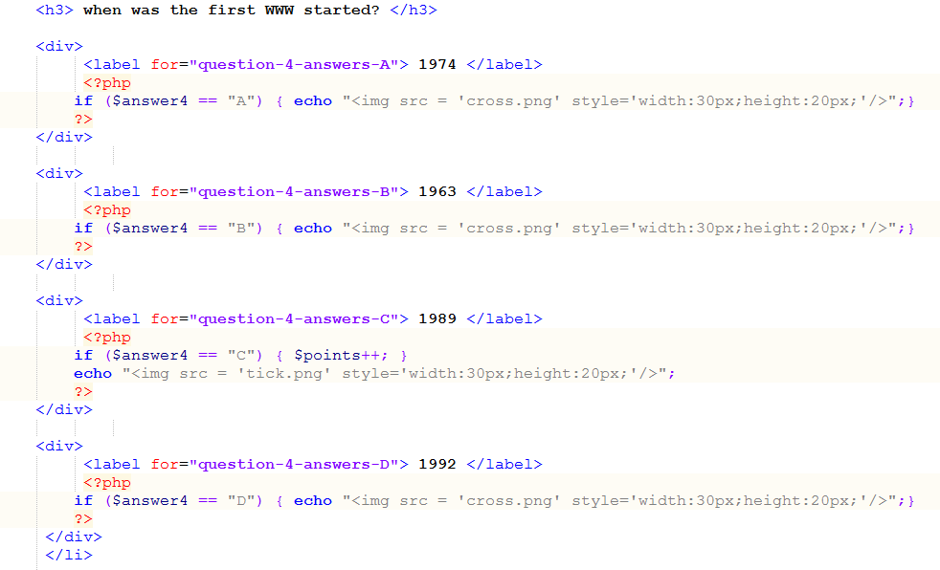
Evaluating Answers

Slide 6
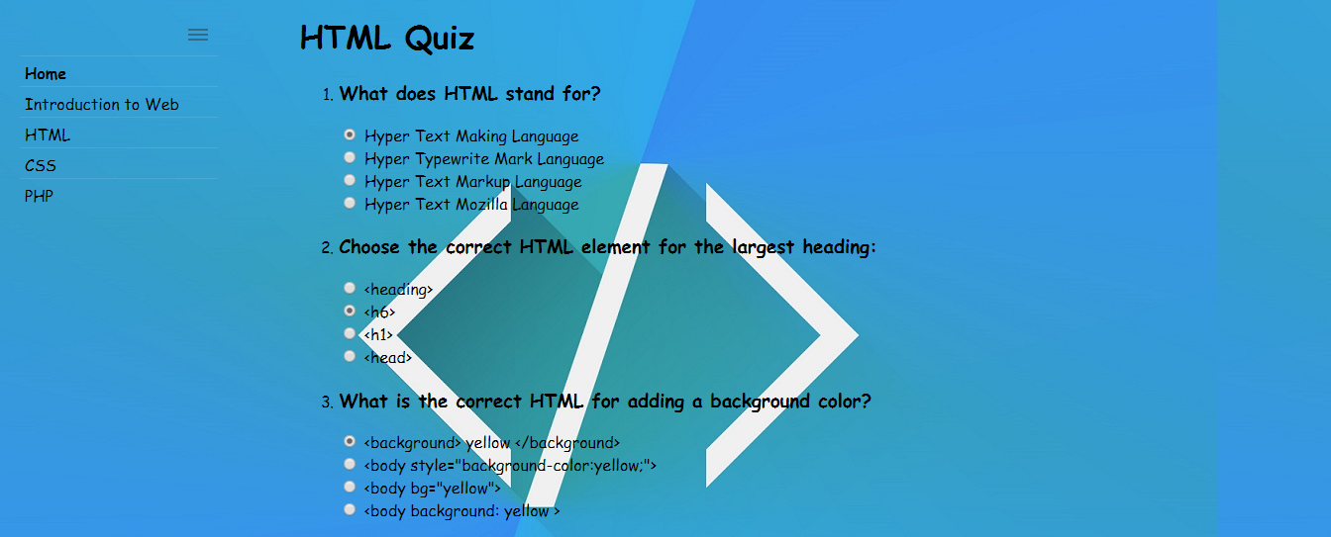
Before submitting the answers

Slide 7
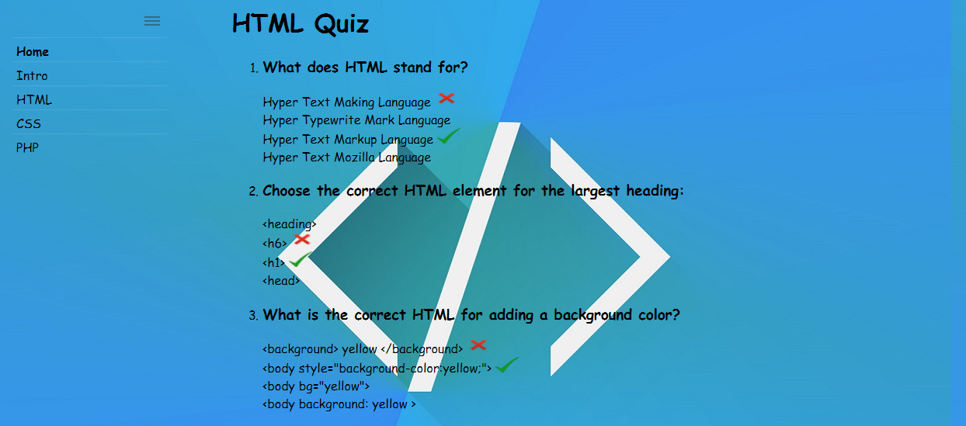
After submitting the answers

Slide 8
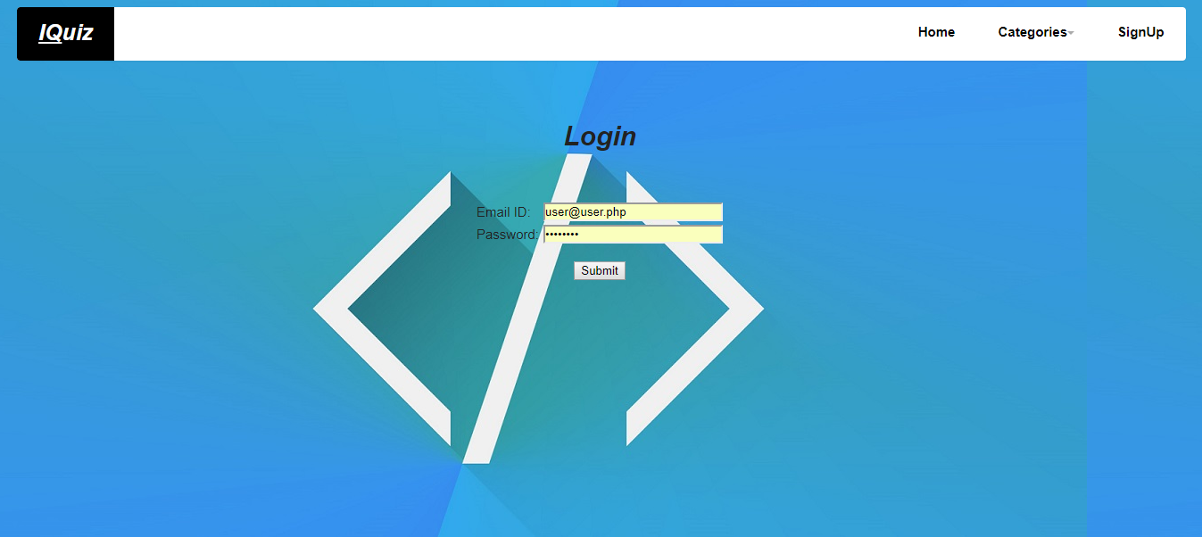
Login Screen

Slide 9
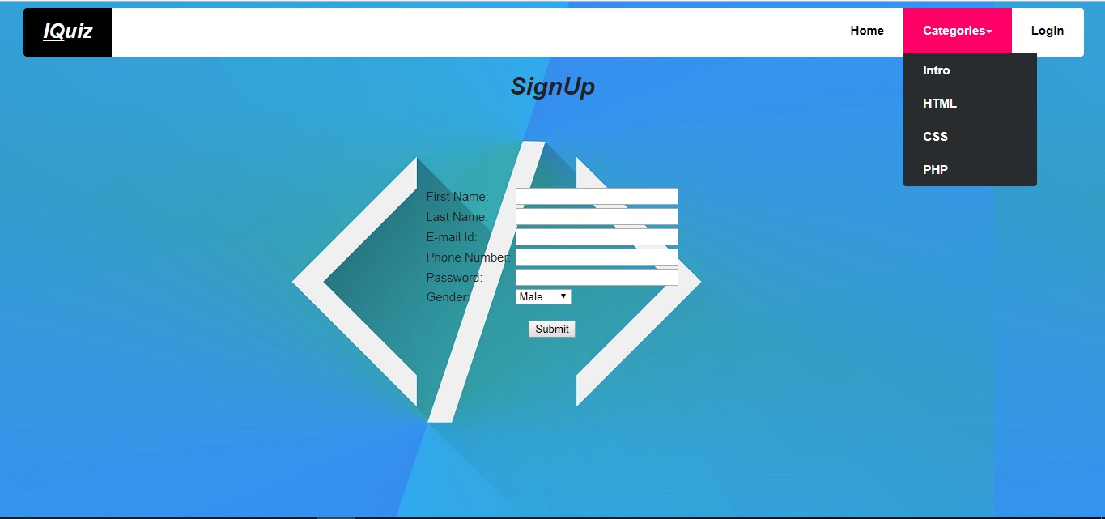
Sign Up Screen

Slide 10


